Slide 1
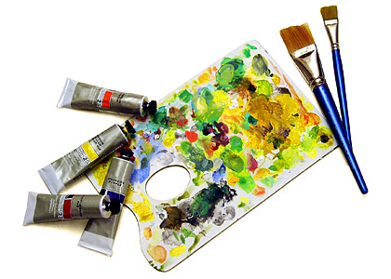

Agile
Applied
A Closer Look at what makes a project agile
Presented by:
Bryan Campbell
MBA, PMP, CSM, ITIL

Slide 2
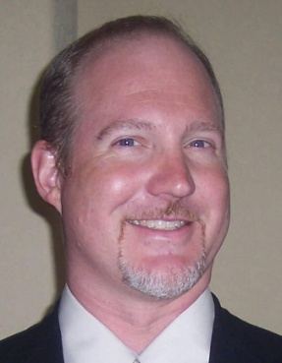
About the Presenter
More than 20 years of IT experience across a wide
range of industries and organizations (government,
public, private)
The last 10 years focused on Agile and UP software development initiatives.
Project and Program Manager of a wide range of small and very large projects.
Extensive experience working in large scale enterprise environments (Telcos, Utilities, Software, Government, Finance)
Recently the VP of Delivery Services for a consulting company specializing in agile software development. Currently, Lead Engagement Manager for OnDemand Solutions at BMC Software Inc.
Articles and blog can be found at www.bryancampbell.com

Slide 3
Agenda
A Brief Refresher on Agile
Hallmarks of an Agile Project
A Walk Through a Typical Agile Project Lifecycle
References and Recommendations

Slide 4
Definition of Agile
Agile is an iterative and incremental (evolutionary) approach to project development
which is performed in a highly collaborative manner
by self-organizing teams
with "just enough" ceremony
that produces high quality software
in a cost effective and timely manner
which meets the changing needs of its stakeholders.
- Scott Ambler, www.agilemodeling.com , Managing Agile Projects

Slide 5
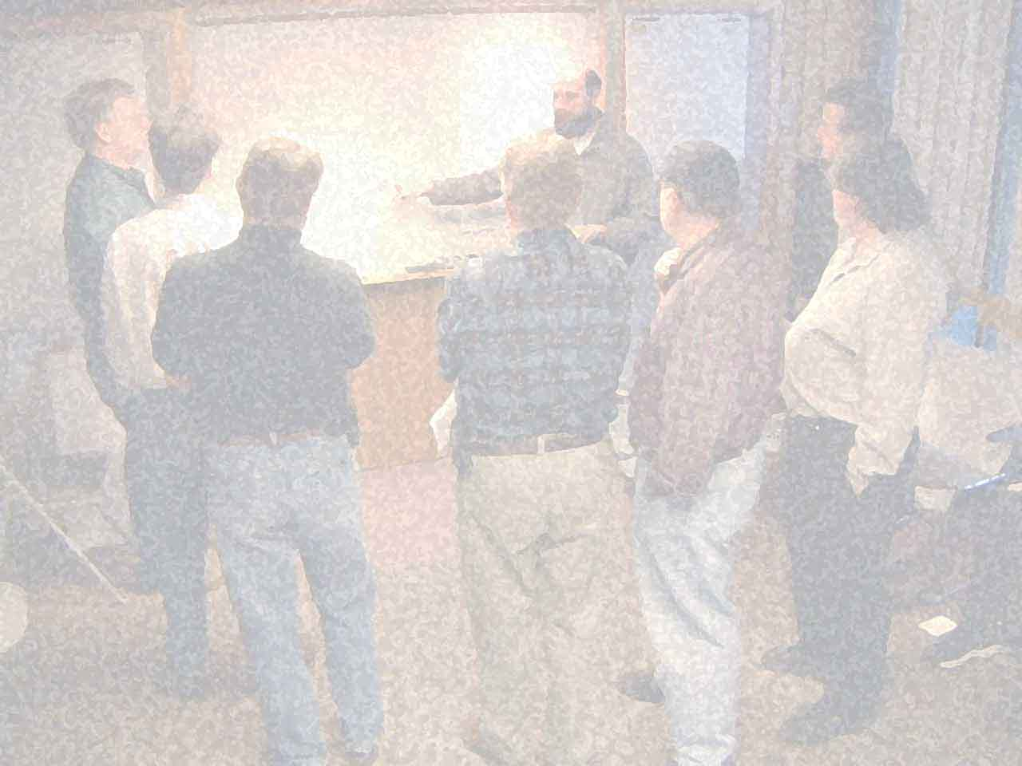
Lest We Forget…
Agile Manifesto
(www.agilemanifesto.org)
Individuals and interactions over processes and tools
Working software over comprehensive documentation
Customer collaboration over contract negotiation
Responding to change over following a plan

Slide 6
The Agile Core
Hallmarks of Agile Project Techniques :
  Iterations with Demos: The project should be broken into a series of time-boxed, iterations that have a demo to show progress to all stakeholders.
  User Stories reflect business value and priority: User Stories are managed in a backlog, prioritized by business value and releases are determined by the development velocity and what is deemed acceptable as a production release.
  Committed Product Owners: Tradeoffs are an important part of the process. Prioritizing business value of work with Business and IT working collaboratively to balance risk.
  Acceptance Tests for all Requirements: Everyone owns ‘quality’. Standards, Test automation and key principles such as Test Early / Test Often are emphasized. Automate tests and enable continuous integration where possible.
  Retrospectives: Weekly team retrospectives should be held to learn how to improve and enhance the project delivery efforts.
  Sustainable Pace/Velocity: Team members are involved in estimates and commitment dates. Overtime, weekend work and heroic efforts are ‘bad smells’.
  Communication: Daily ‘scrums’ should be held amongst team members to understand what has been accomplished, what will be accomplished and what roadblocks exist.
  Visibility: Information on project status, progress and issues/risks should be maintained in real-time, web accessible tools.
Notes:
6

Slide 7
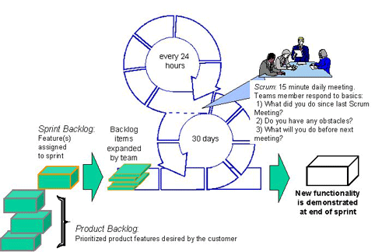
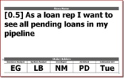

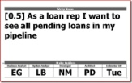
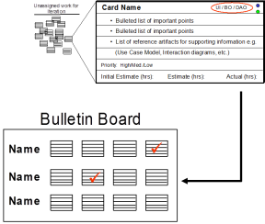
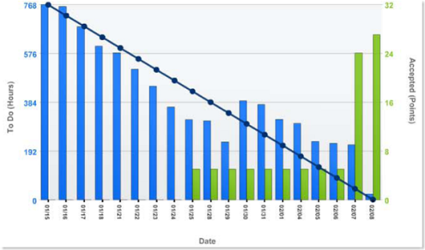
An Agile Project Example
Continuous
Integration
Daily Stand-up
Acceptance Tests
Iterations
Product Owner
User Stories
Demonstration of
Working Software
Visibility and Velocity
Retrospective

Slide 8

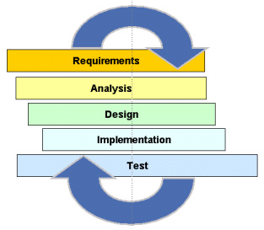
Iterations
A cornerstone of Agile Projects is the concept that the project is broken into a series of iterations (or sprints)
Each iteration is a timeboxed and follows a consistent, predictable and repeatable pattern
Each iteration has an output of a demonstrable, deployable amount of functionality showing business value from an end-user perspective.
Each iteration follows components
of the a standard SDLC
Iterations also closeout with a
retrospective on how what worked
and what could be improved

Slide 9
Iteration Example
Demo
Review the goals
Review the tests
Run thru the script
Document the errors
Week 1
Week 2
Week 3
Story Development
Build the tests
Fail the tests
Develop the stories
Pass the tests
Iteration
Planning
Demo
Preparation
Iteration Preparation
Review the stories
Map out the tasks
Forecast the work
Work the plan
Review the plan
Check the numbers
Highlight the good
Document improvements
Retrospective
Set the goals
Identify the value
Assess the architecture
Agree on the tests
Review the plan
Check the numbers
Get Feedback
Document improvements

Slide 10
Iteration Tips and Tricks
Iterations should rarely be longer than 4 weeks
Iterations less than 1 week or less have too much overhead
Pick an iteration length that will allow the team to demonstrate tangible units of business value
Select iteration duration around the overall delivery date of the product
Select an iteration length that can be supported by both clients and the development team
Projects with considerable 'architecturally significant' amounts of functionality of high degrees of novelty typically require longer iteration cycles
Signs that your iteration length is incorrect
  Development teams 'miss' demos
  Team velocity shows a 'sine wave' effect
http://it.toolbox.com/blogs/agile-pm/how-to-select-the-right-iteration-length-24173

Slide 11
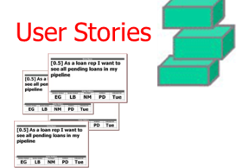
User Stories
All projects start with some form of requirements, User Stories are the Agile form of documenting these requirements
Work performed in an iteration is defined by its user stories
All User Stories are written from the perspective of the ‘value’ that an end user will receive
Usually short, often written on a card, and validated by an acceptance test
Card – Conversation – Confirmation
"As a <role>, I want <goal/desire> so that <benefit>"
http://www.agilemodeling.com/artifacts/userStory.htm

Slide 12
Example User Story Card
Color codes can be used to identify the type of story: user story or engineering story
Card number is used for tracking purposes.
Card Name
No:
Description "As a <role>, I want <goal/desire> so that <benefit>"
Bulleted list of important points
List of reference artifacts e.g. Use Case Model, Interaction diagrams, etc.
Acceptance Tests (sometimes on the back of the card)
Story Points: _____________
_____________ :Value Points
Initial Estimate (hrs):
Remaining Estimate (hrs):
Actual (hrs):
Story Points reflects the effort the card has relative to other cards
Simple estimates for managing resourcing and calibrating estimates
Value Points reflects the business value of the card relative to other cards

Slide 13
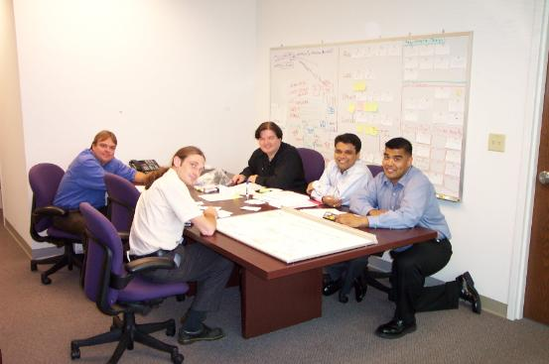
Fun with Cards
Always agree with the team
on ‘what is done’
Have testers ‘check’ cards
that developers say are
completed with a big red marker
Show completed cards prominently
Make completion of cards fun,
  ring bells when they’re completed,
  offer small tokens as rewards,
  offer ‘achievements’
http://www.bryancampbell.com/WallofWonder.htm

Slide 14
Story Points and Estimating
Try and break stories down into manageable chunks of functionality/value
  Manageable by one person
  Shouldn’t take more than one or two days to complete
Pick one well understood story as a baseline and establish its point value
Compare all other story cards to this one
At the end of each iteration, calibrate points to effort recorded on cards

Slide 15

Story Points
One aspect of agile estimating is the concept of “Relative Estimating”
Which is easier to estimate:
Absolute
24 oz
16 oz
8 oz
Relative
Large
Medium
Small

Slide 16
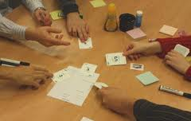
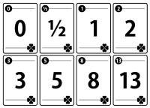
Planning Poker
One way to estimate story point effort is to use a game of planning poker
Each member of the team receives a deck of numbered cards
The product owner reads each
story card and answers any questions
Each team member estimates the effort
using a relative estimate and everyone shows their hand at once
Outliers (high or low) talk about why they made their estimate
After the discussion team members re-estimate until convergence is achieved
http://www.planningpoker.com

Slide 17
Value Points
Agile emphasizes delivering value and outcomes
Applying the same relative sizing techniques to the value of stories helps provide a view into overall value delivery
This also engages the Product Owner and business stakeholders in quantifying the value of the stories/features
Brings real power to measurements

Slide 18
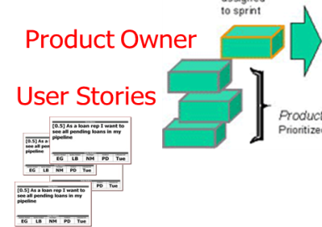
Product Owners
Integral part of the Agile process
Clear owner of business value and priority
Must be able to prioritize backlog and balance against delivery commitment and budget
  Remember: Customer Collaboration versus Contract negotiation
Actively involved in writing user stories and validating functionality

Slide 19
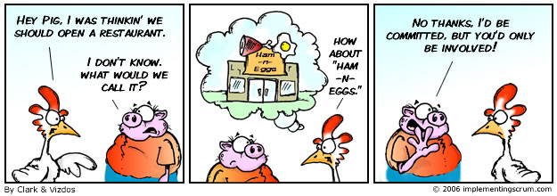
Scrums, Pigs and Chickens
One familiar adage used in Scrum projects is the differentiation between Pigs, committed project team members and Chickens, stakeholders not formerly part of the project team. During scrums only Pigs are allowed to provide project status.
http://www.implementingscrum.com/2006/09/11/the-classic-story-of-the-pig-and-chicken/

Slide 20
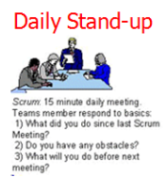
Daily Stand-up
Each day the Scrum team gathers to provide an update on progress:
  Each person answers three questions
    What did you do yesterday
    What will you do today
    Are there any issues/obstacles you are facing
Who provides Scrum updates?

Slide 21
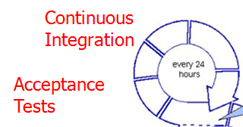
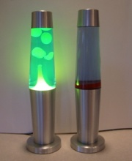
Acceptance Tests and
Continuous Integration
Part of the User Story should be a collection of tests that must be met for acceptance
These are ‘Black box’ tests – test functionality not internal components
Continuous integration takes unit tests – white box tests and continuously compiles creates system builds as code and their tests are checked in
If the build breaks, developers must immediately fix their code
Often continuous build machines are hooked to visual indicators like lava lamps to show status –
Green/Good Red/Bad

Slide 22
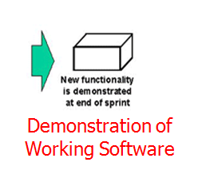
Demos
Every iteration must end with a demo
Demos are the only way to get ‘credit’ for completed work
Demos are important opportunities to:
  Receive feedback from stakeholders
  Recognize the success of the team in accomplishing an important milestone
  Provide a natural break-point for teams (note: good iterations start on Mondays and finish on Fridays)
http://it.toolbox.com/blogs/agile-pm/whats-in-a-demo-29494

Slide 23
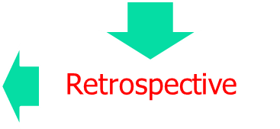
Retrospectives
Occur at the end of every iteration
Identify what worked well and what needs improvement
Use metrics to help identify systemic issues (reduced velocity, estimate variances, increases in defects)
All project participants attend
Make results visible and accessible

Slide 24
Retrospectives Retrospective
Establish a facilitator for your retrospective
  Encourage Root Cause analysis
  Steer the team away from the ‘F’ word “Feelings”
Give your retrospectives ‘themes’:
  “How Can we Improve Teamwork” or “Increase Quality”
Get participants engaged
  Use a Talking Stick
  Use the Fist of Five to vote on priorities
  Consider using Speedboat as opposed to a Pluses and Minuses flipchart
Change things up
  Hold them in different locations
  Make a “Build a Sundae” or something similar
http://it.toolbox.com/blogs/agile-pm/energize-your-retrospectives-24162

Slide 25
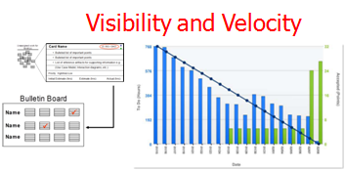
Measurements
Burn-downs
  Show how long it will take to complete all story points
  Each iteration should show progress to accomplishing the outcome of the project
  Credit for completing a story point comes only from demoing the functionality, passing acceptance tests and completing the ‘what is done’ criteria

Slide 26
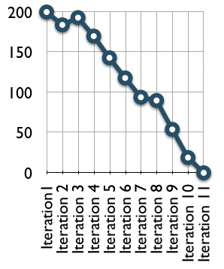
Burn-Down Charts
Show effort remaining for the release
Goal is to get to zero
Intended to be very light-
weight
Provides insight into patterns
  An increase in points between
  iterations means new scope
  Plateaus usually reflect
  technical debt

Slide 27
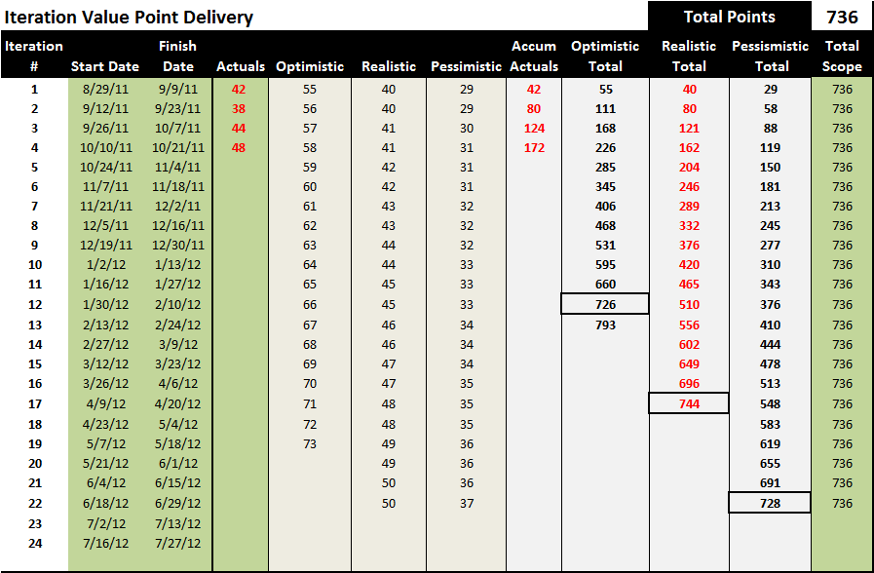
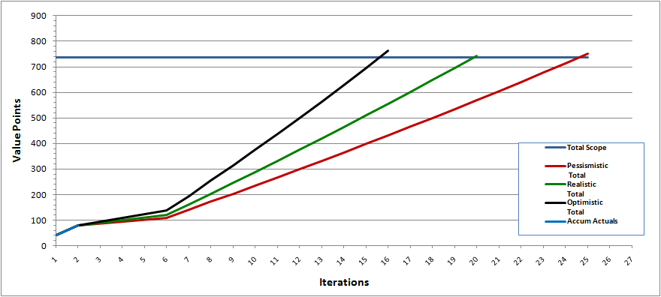
Iteration Value Points
Total Value Points for all stories in backlog
Target dates based on different estimates of velocity
Iterations should be ‘stacked’ with as many high value stories early in the iterations
Burn-up chart shows progress towards the total ‘release’ value of the project

Slide 28
ScrumMaster and Project Manager
Agile describes the ScrumMaster as the buffer between the team and any distracting influences
It’s role is not to direct but to enable the team to achieve success
An Agile Project Manager is also an enabler for the team blending facilitator, mentor and coach into the proess
Agile project managers are also responsible for managing the other PMP process groups (Initating, Planning, Executing, Monitoring/Controlling and Closing)

Slide 29
In Summary
A fast and relatively high level review
  Lots more details in books, blogs and magazines
Aligns with PMI-ACP certification now available
The key is to keep it simple and remember the perfect is the enemy of the good

Slide 30
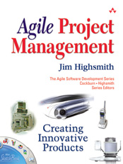
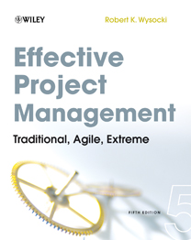
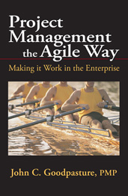
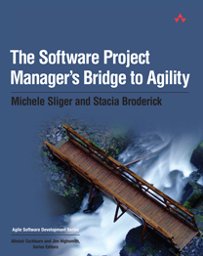
Agile Development and Books
Recommended by the PMI
Methodologies
Scrum
Crystal Clear
Extreme Programming
Adaptive Software Development
Feature Driven Development
Dynamic Systems Development Method
OpenUP
Enterprise Unified Process
Lean Software Development
Techniques
Planning Poker
Fist of Five
Reference Information
Agile Wikipedia Reference
Post-Agilism
The Project Troika

