Slide 1
Software-as-a-Service Portfolio Management Approaches
Bryan Campbell MBA, PMP, ITIL
Senior Program Manager
BMC Software, Inc.
Alan Birchenough BSc, CSM, ITIL
Consultant
Object Information Services

Slide 2

Agenda
Portfolio Management Overview
  PPM: The Five Questions
Software-As-A-Service: The Changing Technology Landscape
  What makes SaaS solutions different
Introducing the Products and Projects
A Framework for managing SaaS projects within a Project Portfolio

Slide 3

Project Portfolio Management
Projects are investments that companies need to manage to their maximum return while
  Optimizing Resource utilization
  Minimizing risk
  Managing constraints
There several schools of thought:
  Investment Discipline
  Payoff Optimization
However, the key is to provide a view that executives can compare projects and make decisions on how to manage their portfolio
  Note: this is not a list of projects and their status!

Slide 4
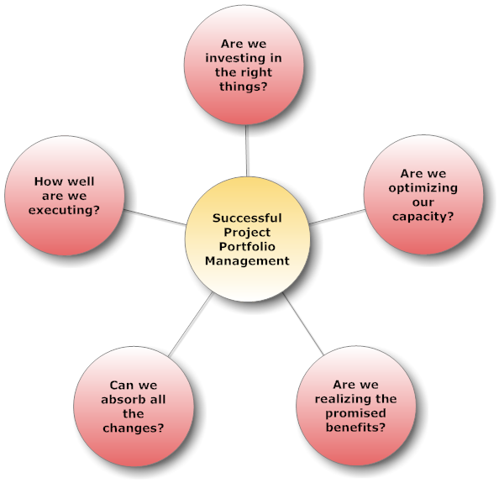

Portfolio Management: The Five Questions
Any view of a portfolio should be able to answer these five questions.
A good portfolio view provides visibility into attributes and the ‘levers’ executives can control to manage the portfolio.
After [EPMC2009]

Slide 5
Software-as-a-Service – What is it?
A “new” approach to providing software solutions
  Multi-tenant solution, many companies use the same infrastructure
  Focus on configuration over customization
  Intent is to ‘free’ companies from managing the costs of hardware and underlying software requirements (operating systems, databases etc.)
  Subscription model versus license/maintenance model
One benefit of this model is a faster implementation model and less operational server/software management
Another is the introduction of a ‘service’ philosophy, subscriptions service don’t have the same ‘lock-in’ as in-house license solutions

Slide 6
Key Points
Investment Considerations
  SaaS implementations are not all "configure and go" as vendors sometimes claim and stakeholders wish
  We have seen cases of significant over- and under-triage
Execution Considerations
  Flouting stakeholder expectations can derail your project – understand and then communicate!
  SaaS solutions enable and call for agile delivery where possible
  You cannot scale agile, but you can "embed" it
Capacity, Change, Benefit Considerations
  We'll look at some of these later

Slide 7
SaaS: Coming soon to a value chain near you
SaaS is having a major impact on technology projects
  17% growth for cloud computing and SaaS firms vs. 4.8% for on-premises software for 2010 (Gartner)
Rapidly growing in every major software segment
  Gartner has forecast the worldwide SaaS market to double from $8 billion in 2009 to $16 billion by the end of 2013
  17% growth for cloud computing and SaaS firms vs. 4.8% for on-premises software for 2010.
  IDC reported SaaS growth surged by more than 40 percent in 2009 despite the global IT down
Not all SaaS solutions are equal
  Gold rush mentality still at play which can impact your project

Slide 8
SaaS Education
The "Hard Way“
  9 SaaS implementations in the last two years
Retrospectively
  Learned from past experiences
Qualitatively - so far
  Attempting to develop a quantitative / empirical framework

Slide 9
Real-World SaaS Portfolio Experiences
Describe the Projects / Products
Examine the Triage Model
Apply the Model
Discuss Some of the Results
Make Recommendations
Invite Discussion

Slide 10
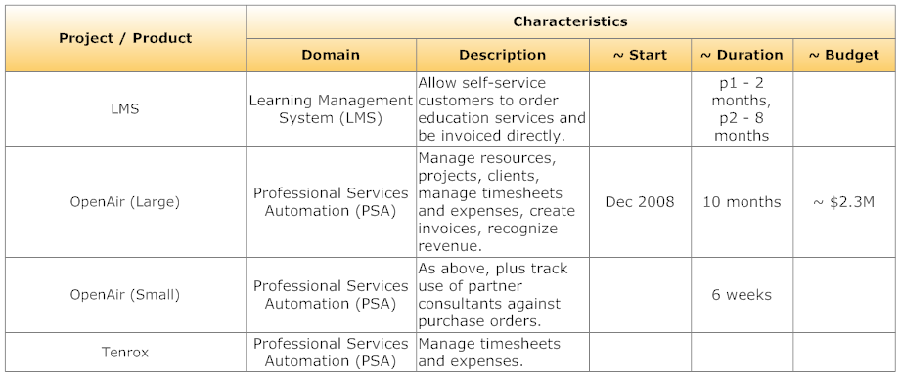
Introducing the Projects / Products

Slide 11
Agile Scaling Factors (Ambler)
From [AMBL2009]

Slide 12

Agile and Plan-Driven Risk Factors
(Boehm & Turner)
Environmental Risks
  E-Tech: Technology uncertainties
  E-Coord: Many diverse stakeholders to coordinate
  E-Cmplx: Complex system of systems
Agile Risks
  A-Scale: Scalability and Criticality
  A-YAGNI: Use of simple design or YAGNI
  A-Churn: Personnel turnover or churn
  A-Skill: Not enough people skilled in agile methods
Plan-Driven Risks
  P-Change: Rapid change
  P-Speed: Need for rapid results
  P-Emerge: Emergent requirements
  P-Skill: Not enough people skilled in plan-driven methods
[BOEH2003]

Slide 13
Correlating Risks and Scaling Factors

Slide 14
Consolidating the Model
Add the following into the model:
  Tvol: Team Volatility
  Chg: Rapid Change
  STSz: Number of Senior Stakeholders
  EReq: Emergent Requirements
  Speed: Expectation of Speed
Interestingly, Tvol, Chg, and EReq were not very significant in our comparisons
  EReq varied only a little, probably because we consciously adopted an "agile" approach to some of the requirements on each initiative

Slide 15
Solution Pattern: "Agile in Parts"
Structure project into Plan-driven and Agile sub-projects or work streams
Partition architecture into Plan-driven and Agile components
Minimizes the amount of ‘culture change’ in being purist

Slide 16
Assessment, Planning and Management Process

Slide 17
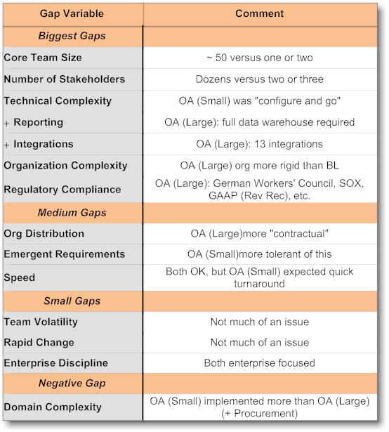
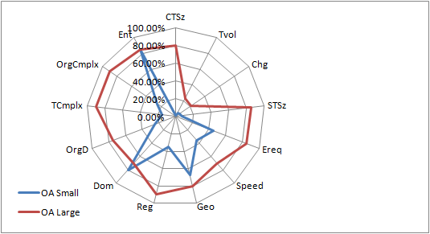
Profiling the Projects & Comparing Two

Slide 18
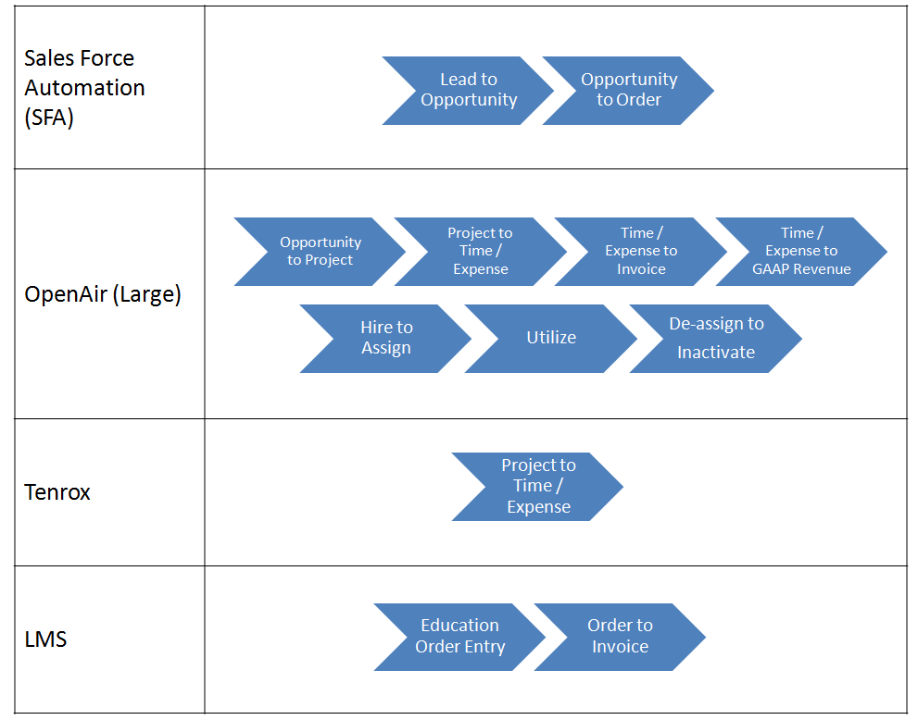
On Domain Complexity

Slide 19
Recommendations
Do not treat all projects the same
  Learn to compare apples with apples
  Investigate the relevant dimensions for comparison
Assess risks and complexity drivers during the intake process, especially:
  When sizing
  When figuring ROI
Ensure your stakeholders understand whether your project is "a breadbox or a Volkswagen"
Use agile practices on SaaS implementations where possible
  Embed agile in a larger robust structure - don't try to scale it directly

Slide 20
Bibliography

Slide 21
Q&A
?

Slide 22
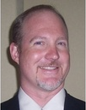
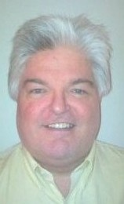
Speaker Bios
Bryan Campbell, MBA, PMP, CSM, ITIL
Senior Program Manager at BMC Software
Keen interest in program management and agile transformations.
Actively engaged in applying, mentoring and teaching Agile and Lean techniques on large scale projects.
Alan Birchenough,
BSc, CSM, ITIL
Currently Senior Business Analyst at Object Information Services
Consults on:
Agile Project Management
Agile Requirements Mgt
Software Process Management
Enterprise Business Architecture.
Recent work has included leading the analysis team on a $5M post-agile SaaS deployment at BMC Software
Previously introduced and directed Executable Agile Requirements on a fixed price $15M custom software development project
Continuously evaluates and learns from, experience with agile, lean, and domain-driven analysis / design
More information is available at www.alanbirchenough.com.
Previously, as the Vice-President of Delivery Services for Valtech Technologies Inc., an Agile and Lean Transformation consulting company, responsible for directing more than 150 consultants applying agile and lean software development techniques.
Frequent speaker at various local conferences and professional organizations, recently presented at the 2009 PMO Symposium, and the APLN Leadership Summit 2009.
My full profile is available at www.linkedin.com/in/bryancampbell.

Slide 23
Contact Information
Bryan Campbell
BMC Software
http://www.bryancampbell.com
(713) 620-3038
bryan@bryancampbell.com
Alan Birchenough
Object Information Services
http://www.alanbirchenough.com
(713) 992-2758
alan@alanbirchenough.com

